Slide 1
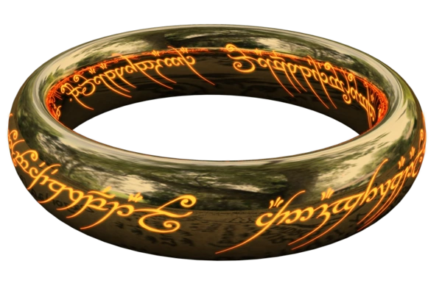
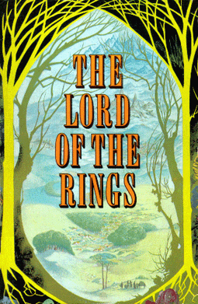
Textual Exploration of LOTR
Blaz

Slide 2

Agenda
Background
Corpuses
Goal
Sentiment Analysis
Topic Modeling
Conclusion

Slide 3

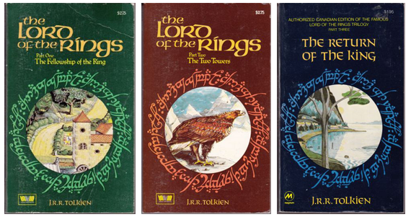
Background
Lord of the Rings
J.R.R. Tolkien

Slide 4

Corpuses
The Silmarillion
The Hobbit
Fellowship of the Ring
The Two Towers
Return of the King

Slide 5

Goal
Sentiment Analysis
Topic Modeling
Learn more about LOTR

Slide 6
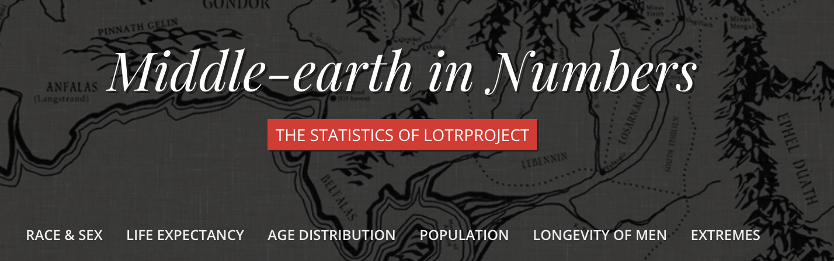
Related Work
Emil Johansson
LOTRproject.com
Sentiment140
Jurafsky and Martin
SALP
Machine Learning w/ Python
Müller and Guido

Slide 7
Sentiment Analysis

Slide 8
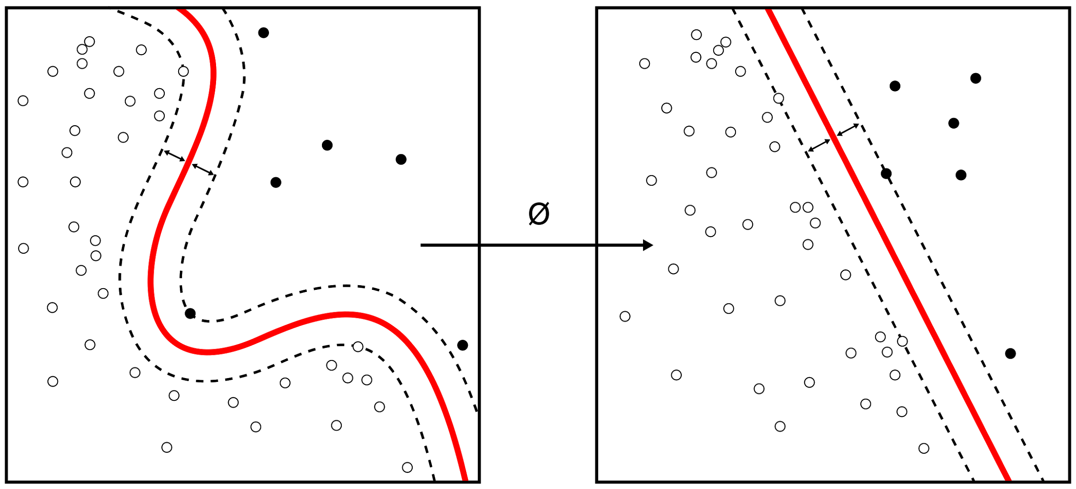
Sentiment140
Naive Bayes
Maximum Entropy
SVM
TwittRatr.com Lexicon

Slide 9

Sentiment Analysis
Sentiment140 API
Chapterize
Pandas

Slide 10


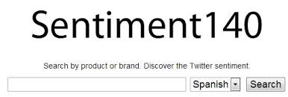
Chapter Objects
Chapterize
S
H
F
T
R
Page Objects
Segmenter
S
H
F
T
R
Requester

Slide 11
Requests
0 - Negative, 2 - Neutral, 4 - Positive
~1,300 Requests

Slide 12




Dataframes
CSVs

Slide 13
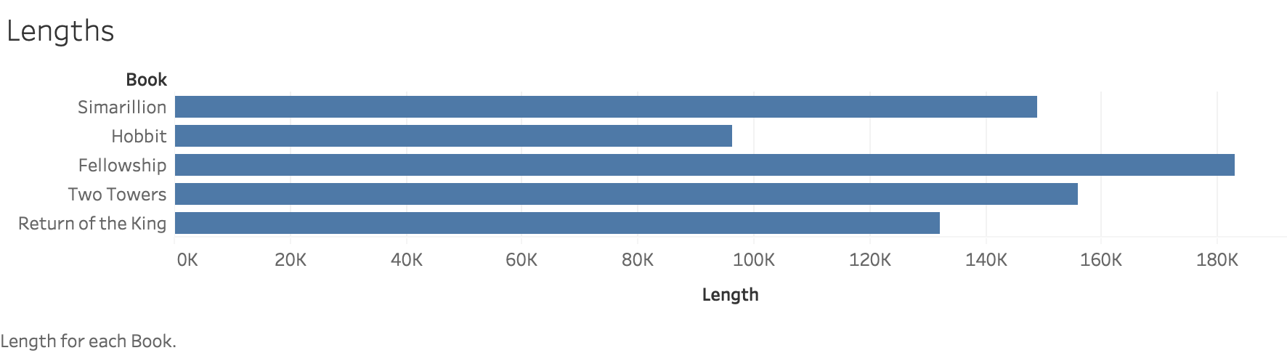
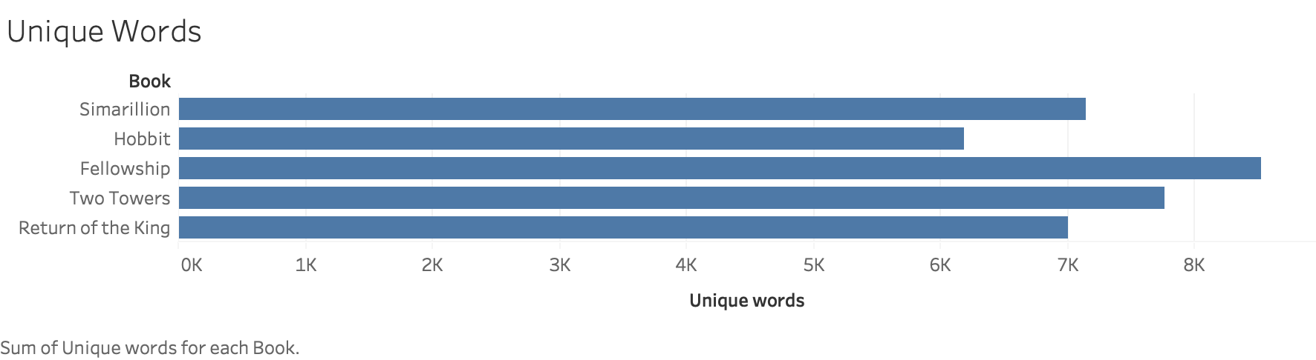
Corpus Information

Slide 14
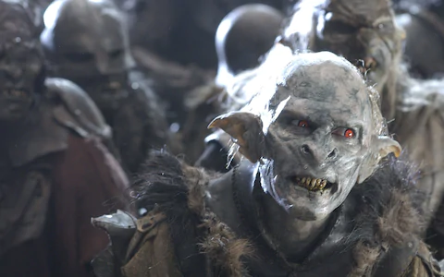
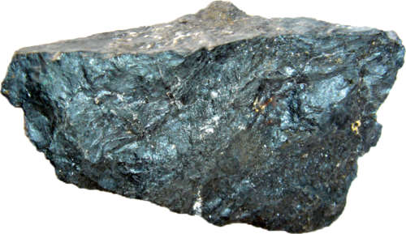
Translation issues
Character names
Sméagol (Gollum)
Éowyn
Orcs

Slide 15
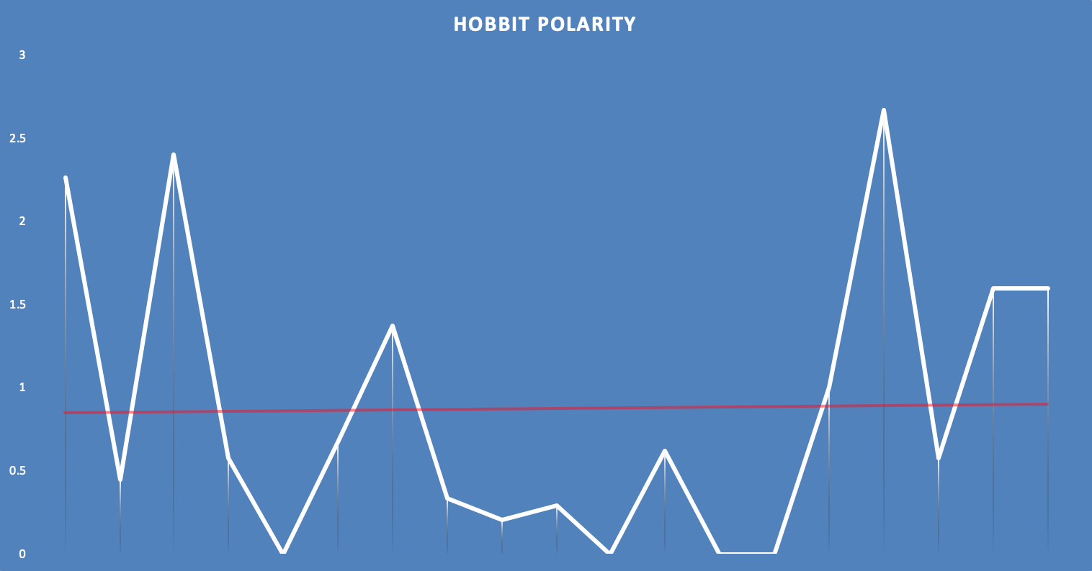
Sentiment averages
Novel
One Adventure
Apart from Trilogy
Book | AVG Polarity
Silmarillion | 1.80
Hobbit | 0.87
Fellowship | 1.22
Two Towers | 1.05
Return | 1.06
Generally between Neutral and Negative

Slide 16
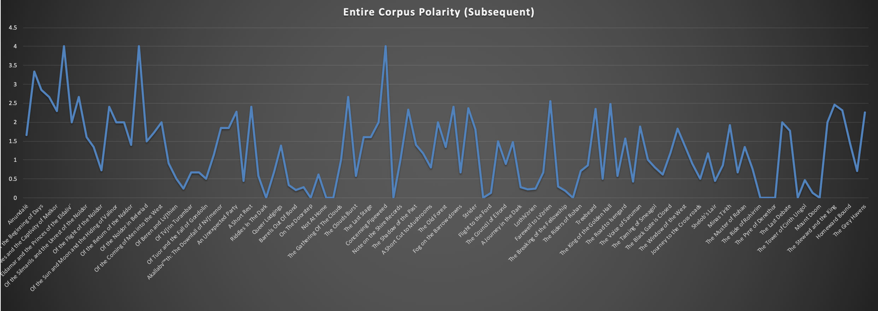
Visuals

Slide 17
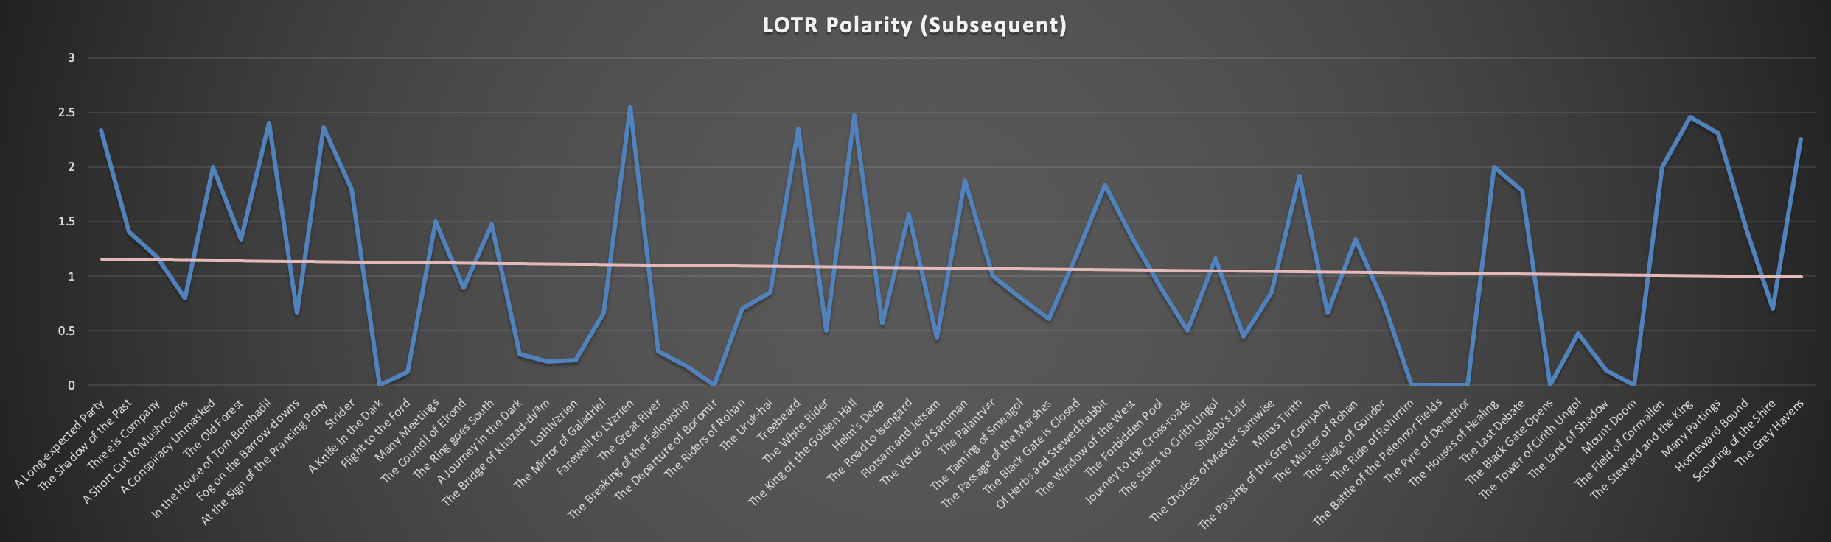
Visuals
Removed The Fellowship prologue
Added Trendline

Slide 18
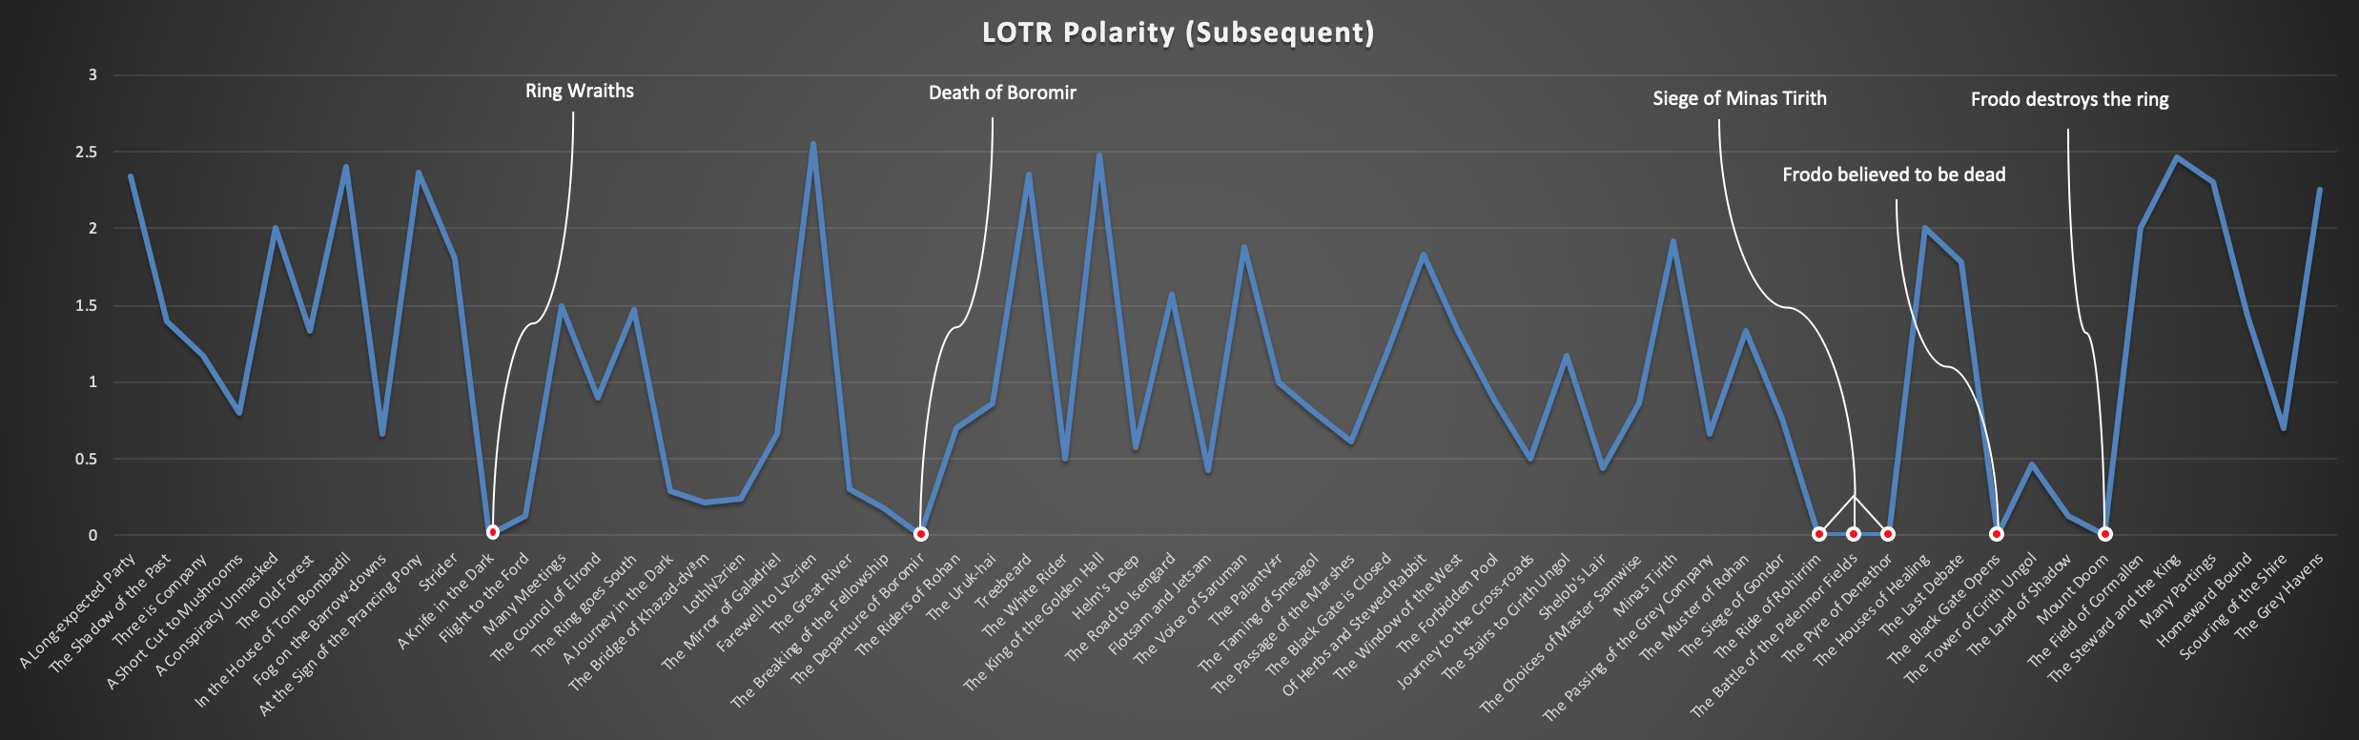
Visuals
Full-Negative Chapters

Slide 19
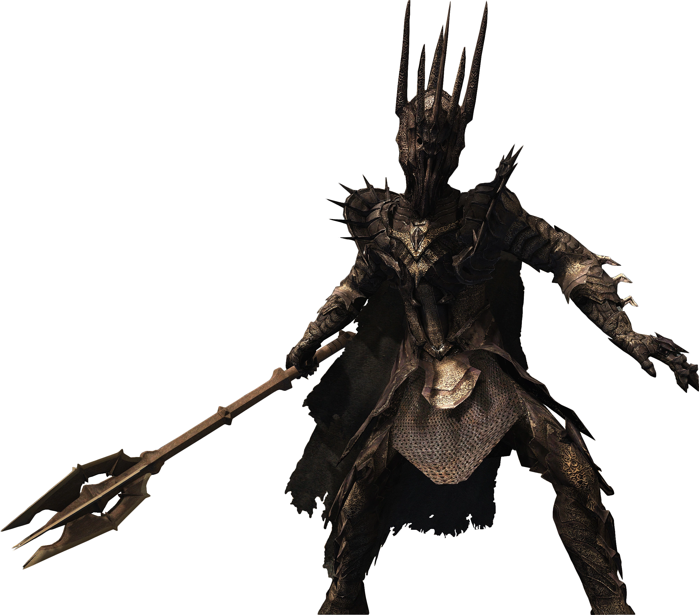
Chapters with Polarity of 0
A Knife in the Dark
The Departure of Boromir
The Ride of Rohirrim
The Battle of the Pelennor Fields
The Pyre of Denethor
The Black Gate Opens
Mount Doom

Slide 20
Common words in Full-Negative chapters
Chapter | Words (In order of frequency)
A Knife in the Dark | Last, us, away, left, road
The Departure of Boromir | Orcs, away, long, boat, wind
The Ride of the Rohirrim | Wild, king, road, like, away
The Battle of the Pelennor Fields | King, like, fell, black, city
The Pyre of Denethor | Lord, stood, city, door, away
The Black Gate Opens | Mordor, black, sauron, last, away
Mount Doom | Mountain, master, away, dark, last

Slide 21
Topic Modeling

Slide 22
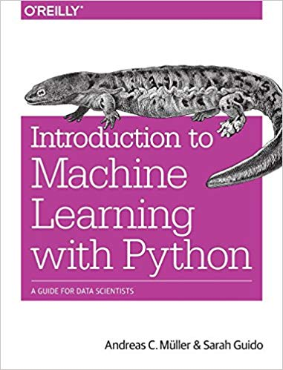
Topic Modeling
LDA (Latent Dirichlet Allocation)
Finds groups of words (features) that appear together frequently
Loosely define these words as ‘topics’
Unlabeled data

Slide 23
Steps
Tokenize
Lemmatization
Stop words/‘Tolkien’ Stop words
Remove words that will dominate the text
Vectorize
Fit to LDA model

Slide 24
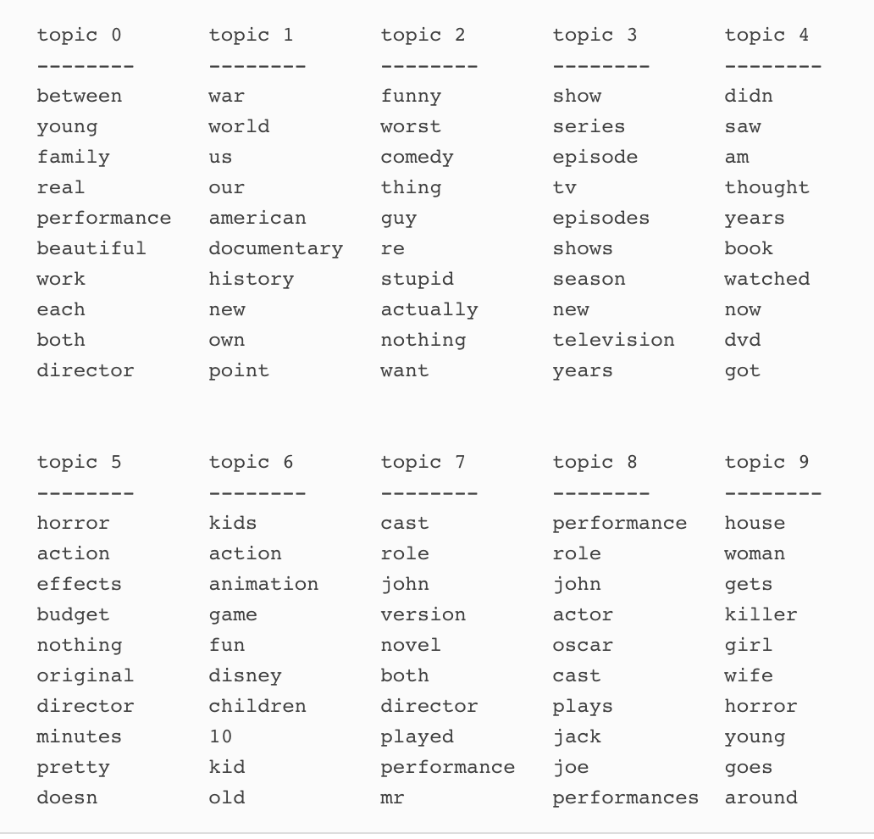
LDA Examples
Supervised learning
Random state
Feature Weights

Slide 25
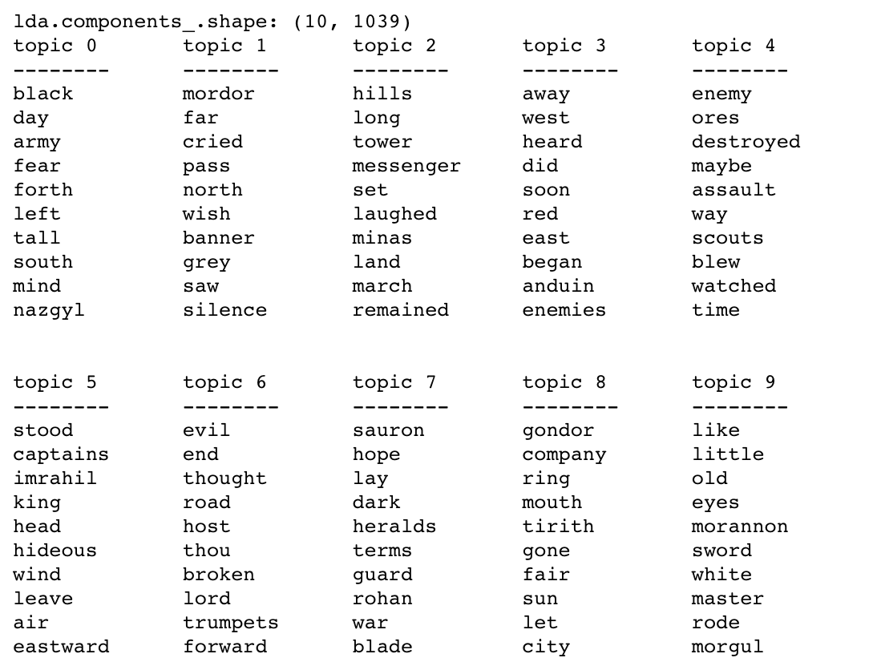
LDA - LOTR
The Black Gate Opens

Slide 26
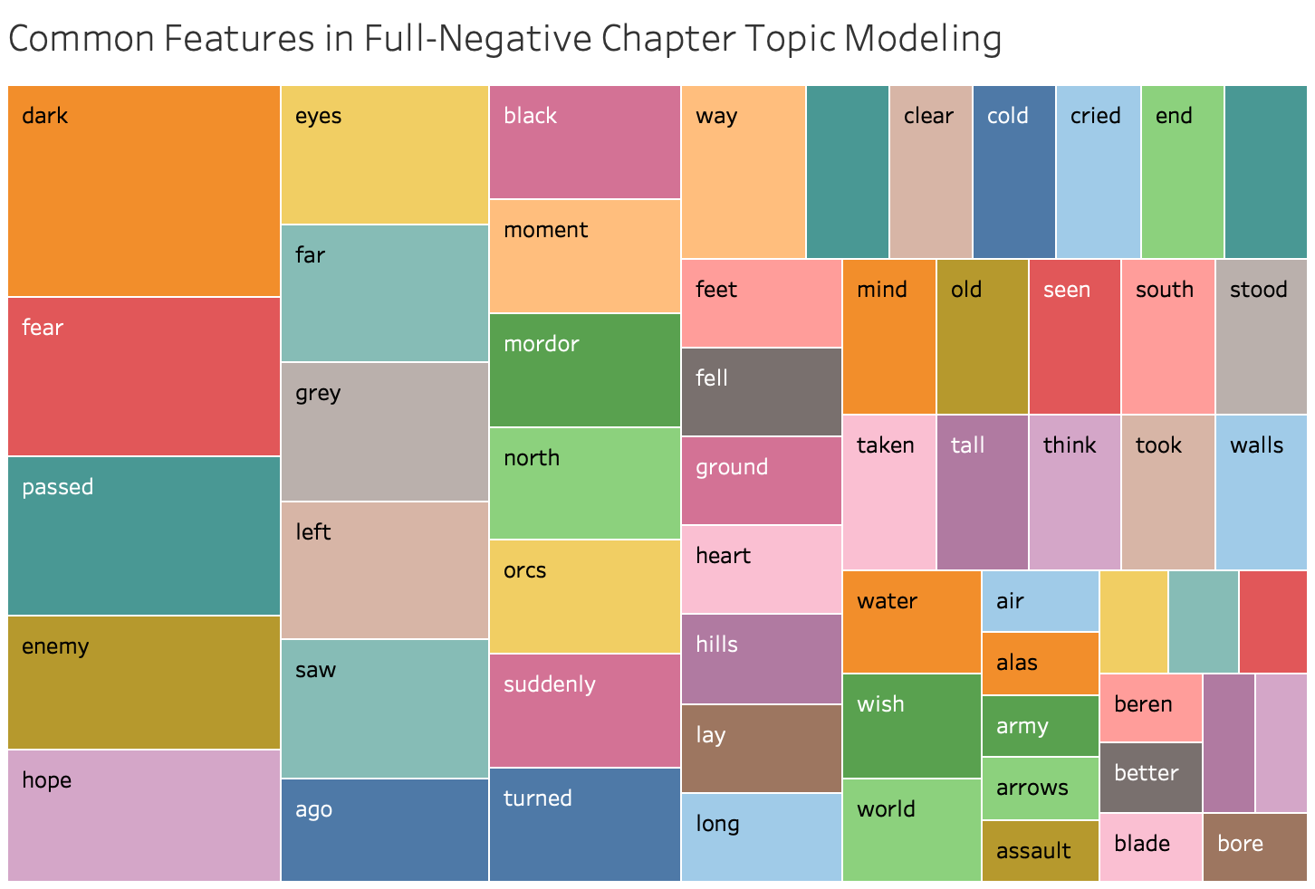

Slide 27
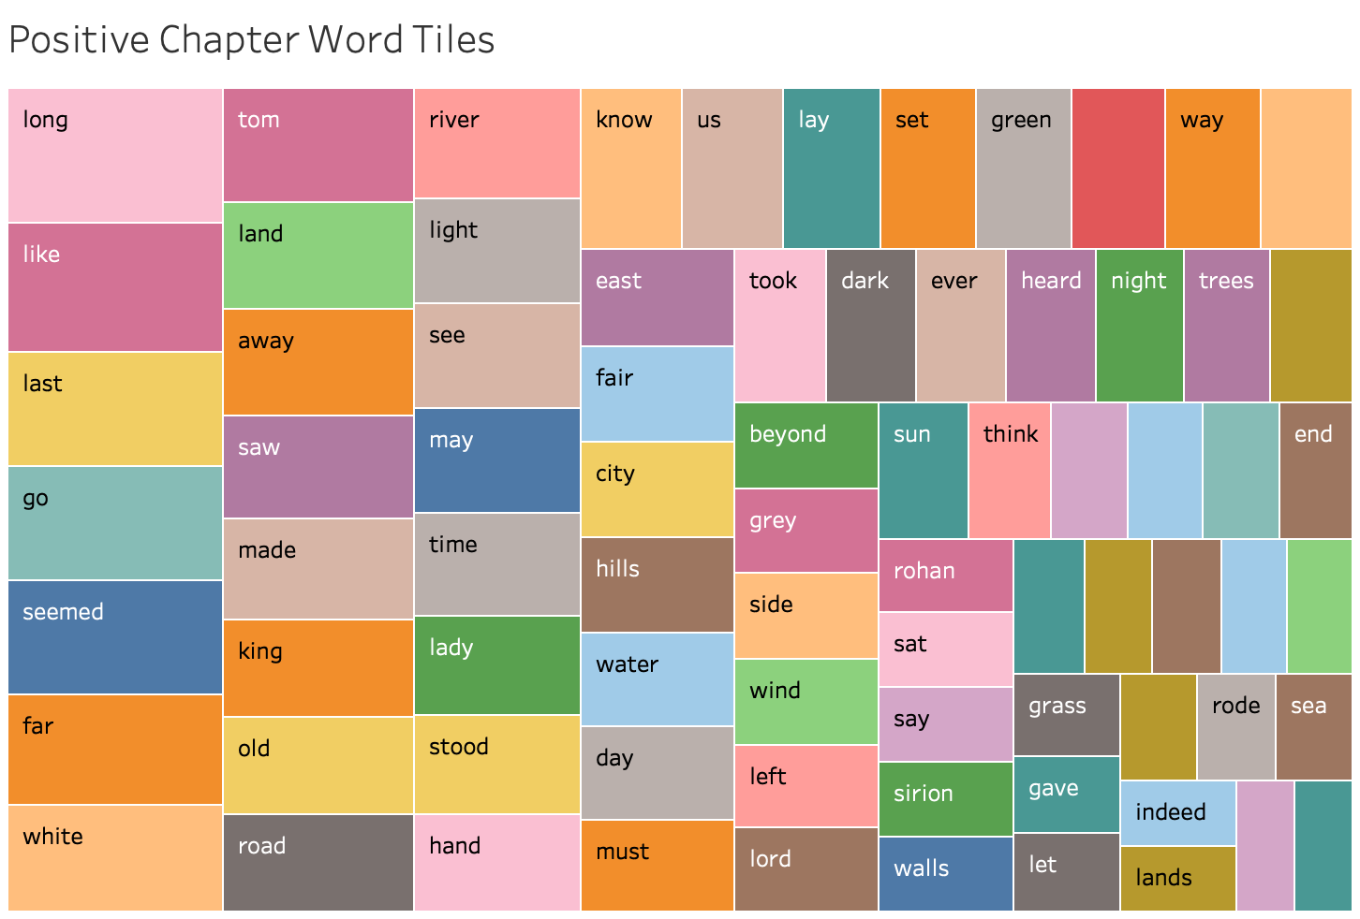

Slide 28
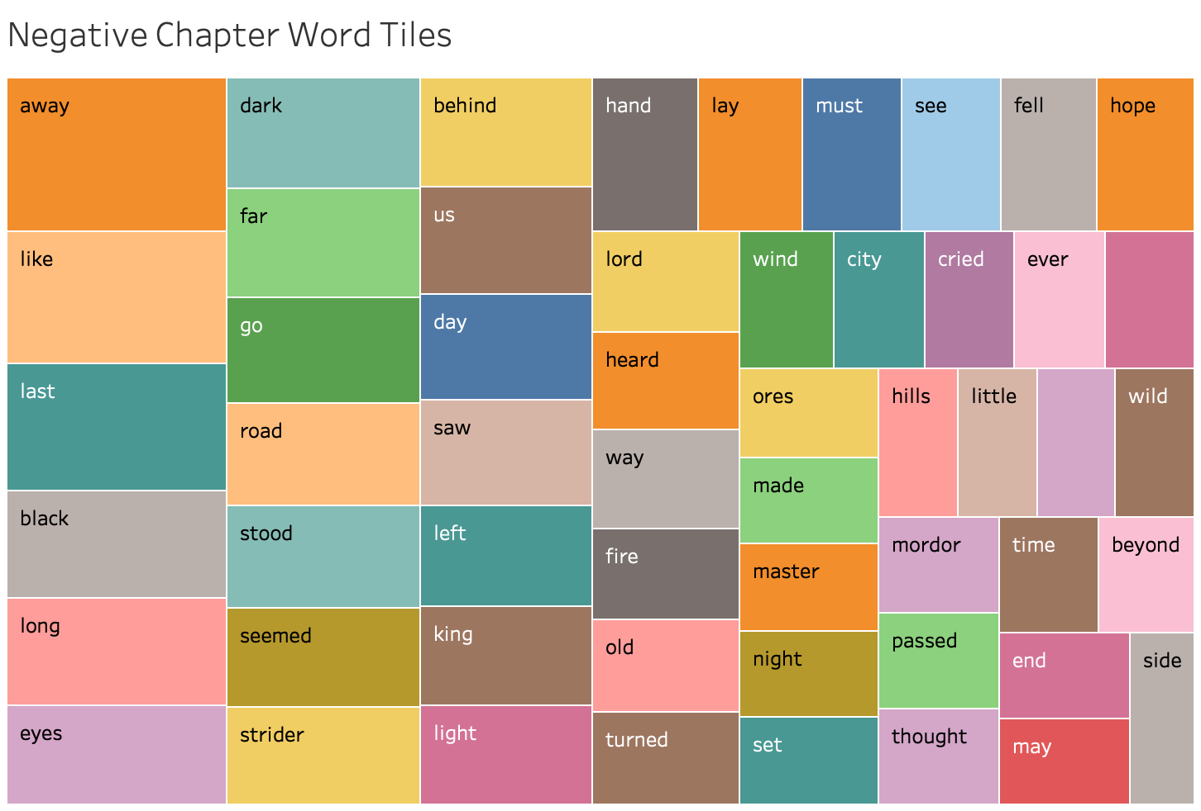

Slide 29
Conclusions

Slide 30
Conclusions
Latent Dirichlet Allocation
Weighted Features
High-Fantasy
Recurrent Neural Networks
Summarization
LOTR

Slide 31
References
Go, Alec, M, et al. Twitter Sentiment Classification using Distant Supervision. Retrieved from https://cs.stanford.edu/people/alecmgo/papers/TwitterDistantSupervision09.pdf
Guido, S. (2016). Introduction to Machine Learning with Python: A Guide for Data Scientists. Retrieved from https://www.safaribooksonline.com/library/view/introduction-to-machine/9781449369880/preface01.html#idm140338259230048

